Slide 1


Blinkit Analysis
STEPS IN PROJECT
Requirement Gathering/Business Requirements
Data Walkthrough
Data Connections
Data Cleaning/Quality Check
Data Modelling
Data Processing
DAX Calculations
Dashboard Lay Outing
Charts Developments and Formatting
Dashboard/Report Development
Insights Generation

Slide 2
Blinkit Analysis
BUSINESS REQUIREMENT
To conduct a comprehensive analysis of Blinkit Sales performance, Customer Satisfaction, and Inventory distribution
to identify key insights and opportunities for optimization using various KPIs and Visualizations in Power BI.
KPI’s Requirements
Total Sales : The overall revenue generated from all sold items.
Average Sales : The average revenue per sale.
Number of Items : The total count of different items sold.
Average Rating : The average customer rating for items sold.

Slide 3
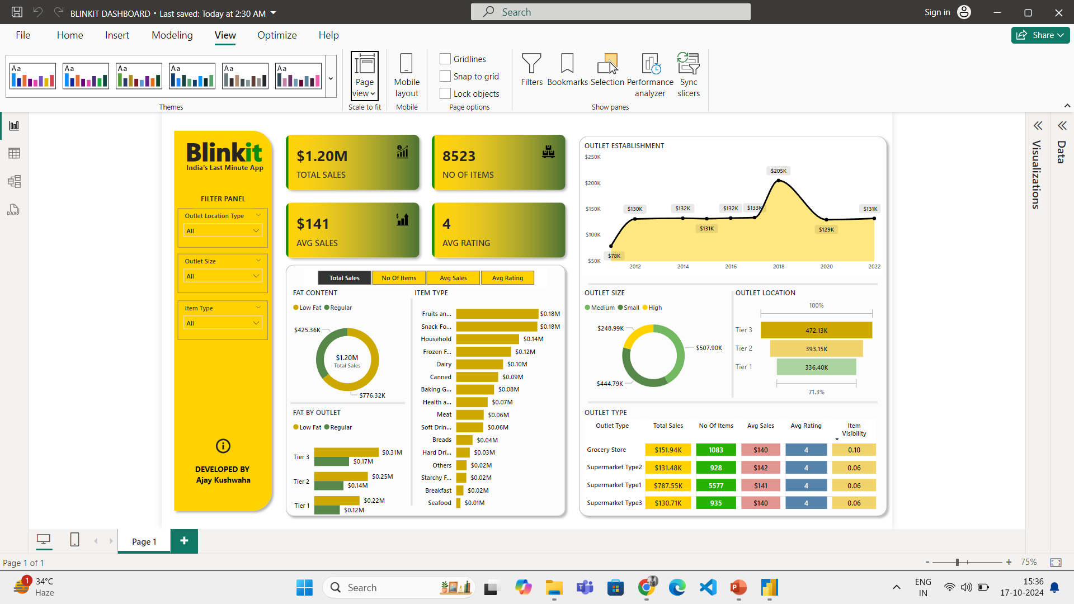
Blinkit Analysis Dashboard
Github link Dashboard File here

